Slide 1
Day 4 - What Networks Could Be
UMN CSS Workshop 2025
Instructor: Alvin Zhou

Slide 2
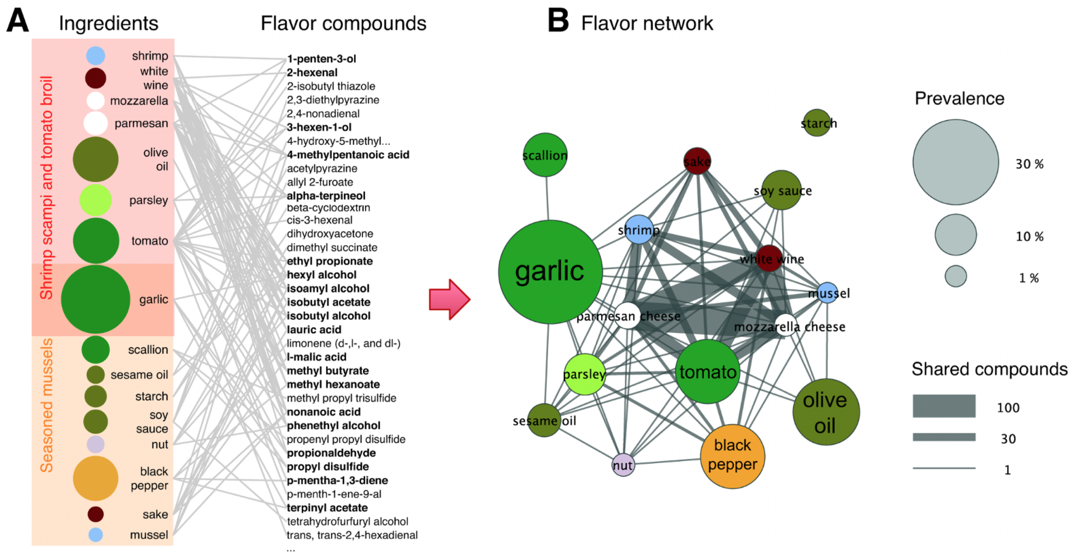
Notes:
What data they have? What’s their question?
(A) The ingredients contained in two recipes (left column), together with the flavor compounds that are known to be present in the ingredients (right column). Each flavor compound is linked to the ingredients that contain it, forming a bipartite network. Some compounds (shown in boldface) are shared by multiple ingredients. (B) If we project the ingredient-compound bipartite network into the ingredient space, we obtain the flavor network, whose nodes are ingredients, linked if they share at least one flavor compound. The thickness of links represents the number of flavor compounds two ingredients share and the size of each circle corresponds to the prevalence of the ingredients in recipes.

Slide 3
Notes:
What’s node, what’s tie, and directed? Weighted? What does the visualization tell us?
(A) The ingredients contained in two recipes (left column), together with the flavor compounds that are known to be present in the ingredients (right column). Each flavor compound is linked to the ingredients that contain it, forming a bipartite network. Some compounds (shown in boldface) are shared by multiple ingredients. (B) If we project the ingredient-compound bipartite network into the ingredient space, we obtain the flavor network, whose nodes are ingredients, linked if they share at least one flavor compound. The thickness of links represents the number of flavor compounds two ingredients share and the size of each circle corresponds to the prevalence of the ingredients in recipes.

Slide 4
Node: ingredient
Tie: shared flavor compound
What else could be the tie?

Slide 5
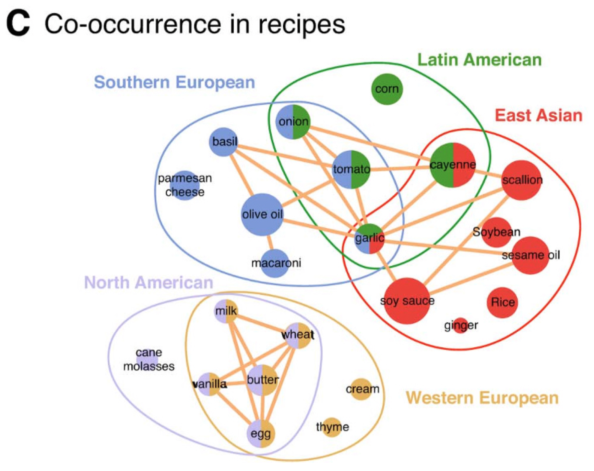

Slide 6
What other kinds of networks could be constructed from the data?
Ahn, Y.-Y., Ahnert, S. E., Bagrow, J. P., & Barabási, A.-L. (2011). Flavor network and the principles of food pairing. Scientific Reports, 1(1), 196. https://doi.org/10.1038/srep00196

Slide 7
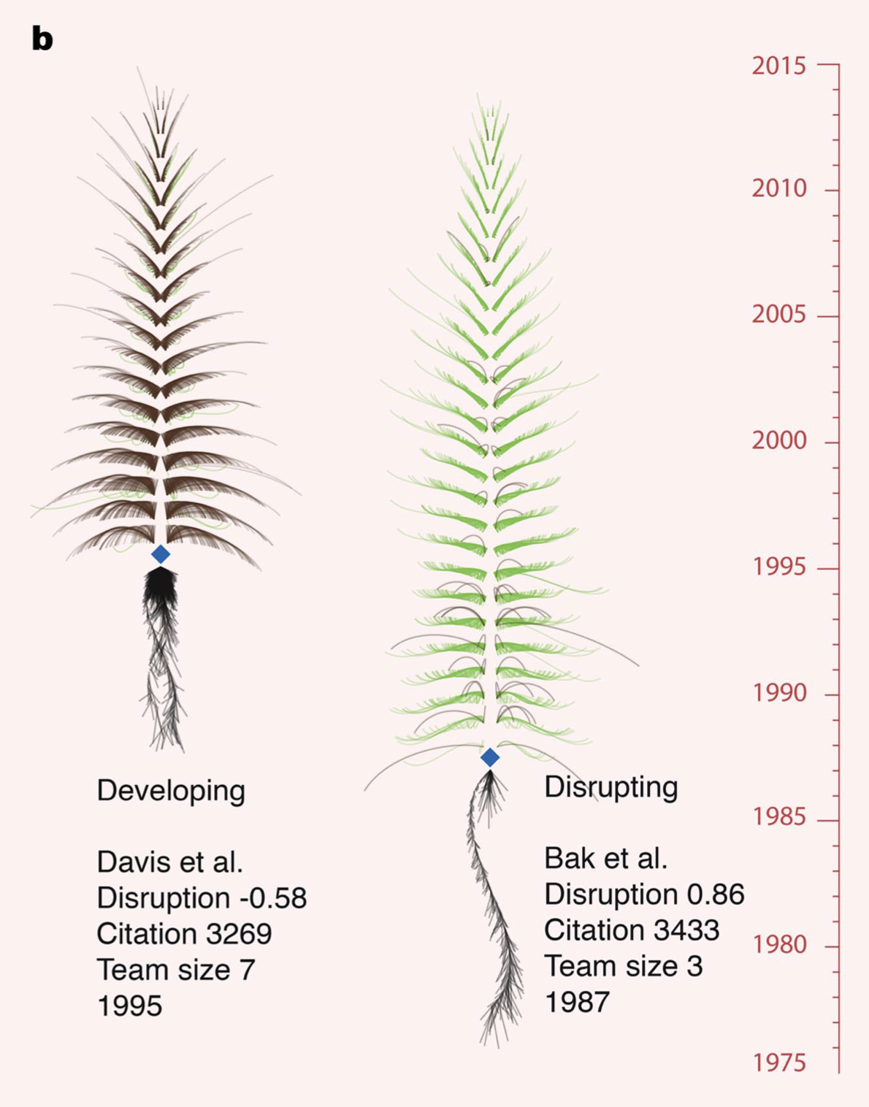
Notes:
b,Two articles (the Bose–Einstein condensation and BWK-model articles) of the same impact scale represented as citation trees, to illustrate how disruption distinguishes different contributions to science and technology.

Slide 8
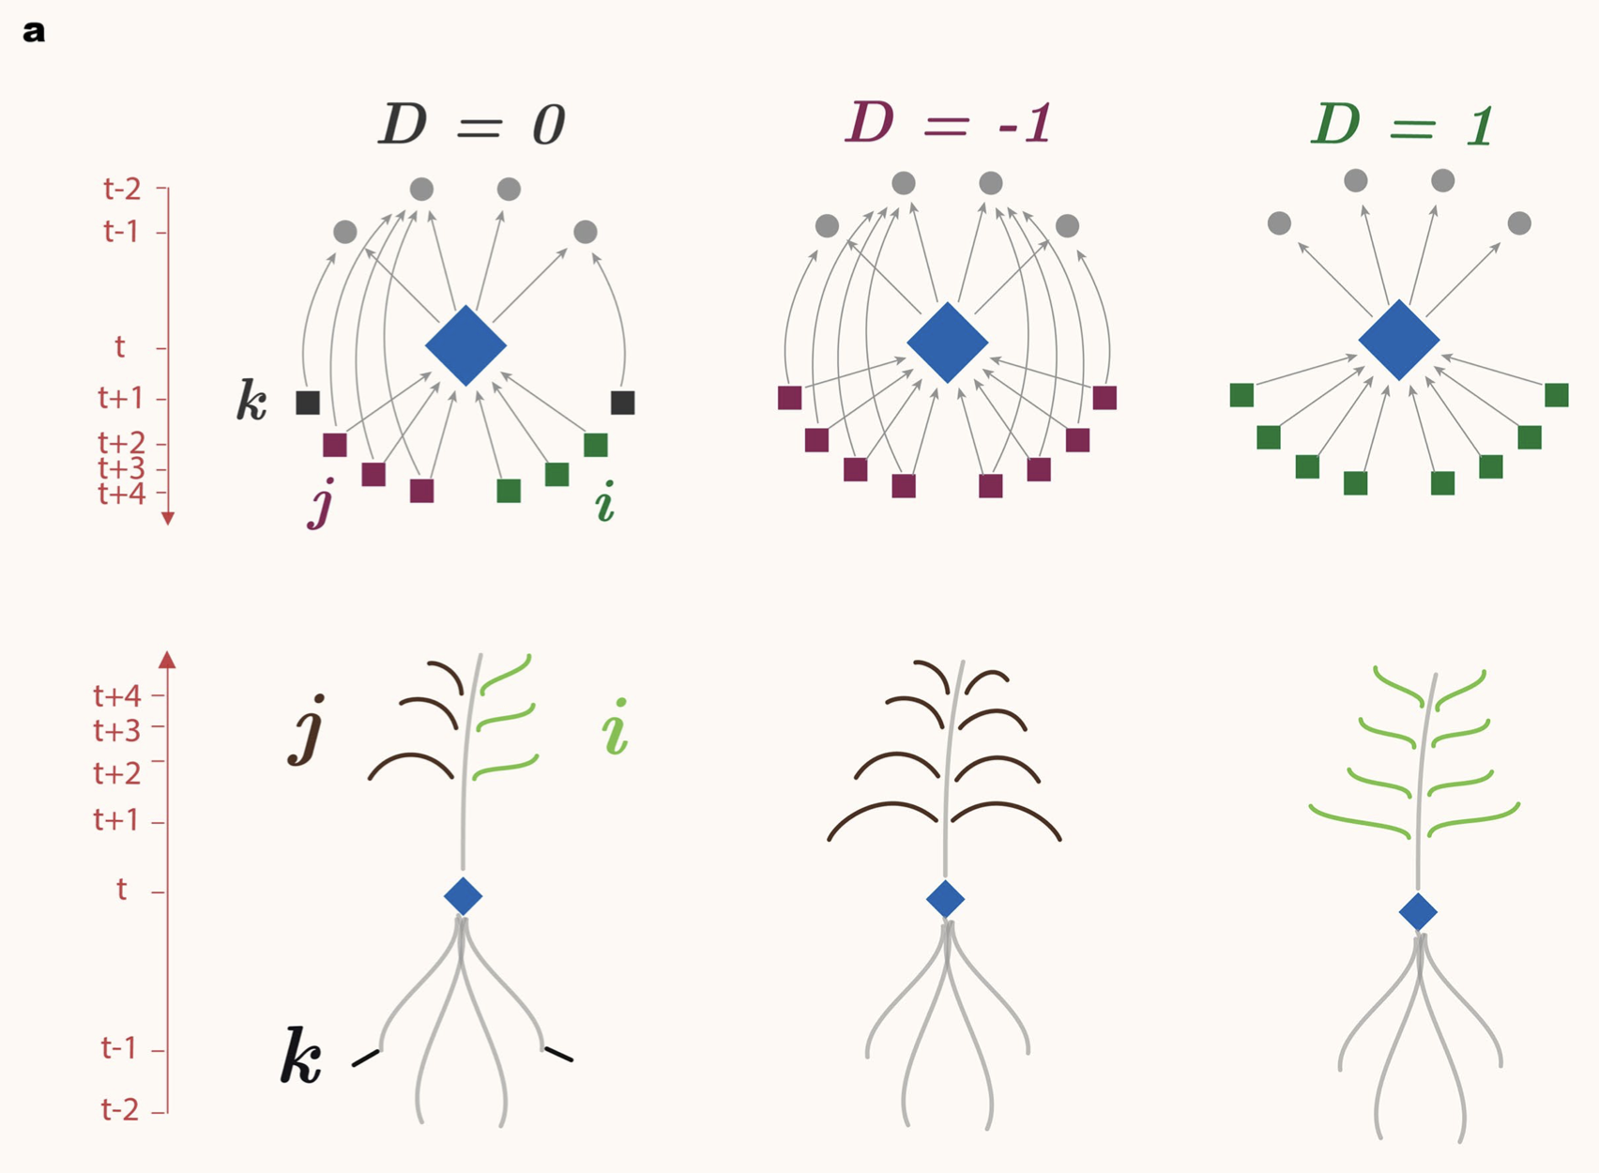
Notes:
a, Citation tree visualization that illustrates the visual influence of focal papers, drawing on past work and passing ideas onto future work. ‘Roots’ are references and citations to them, with depth scaled to their publication date; ‘branches’ on the tree are citing articles, with height scaled to publication date and length scaled to the number of future citations. Branches curve downward (brown) if citing articles also cite the focal paper’s references, and upward (green) if they ignore them

Slide 9
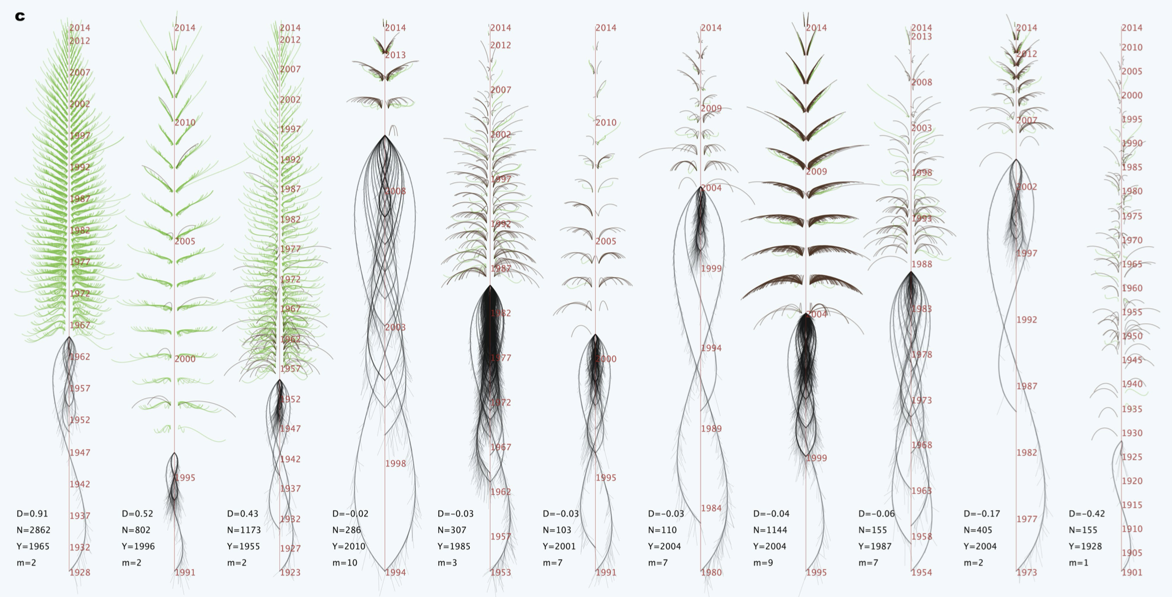
Wu, L., Wang, D., & Evans, J. A. (2019). Large teams develop and small teams disrupt science and technology. Nature, 566(7744), 378–382. https://doi.org/10.1038/s41586-019-0941-9
Notes:
c, Citation tree visualization that characterizes the visual influence of eleven focal papers from teams of different sizes. Disruption (D), citations (N), published year (Y) and team size (m) of papers are shown in the bottom left corner of each tree.

Slide 10
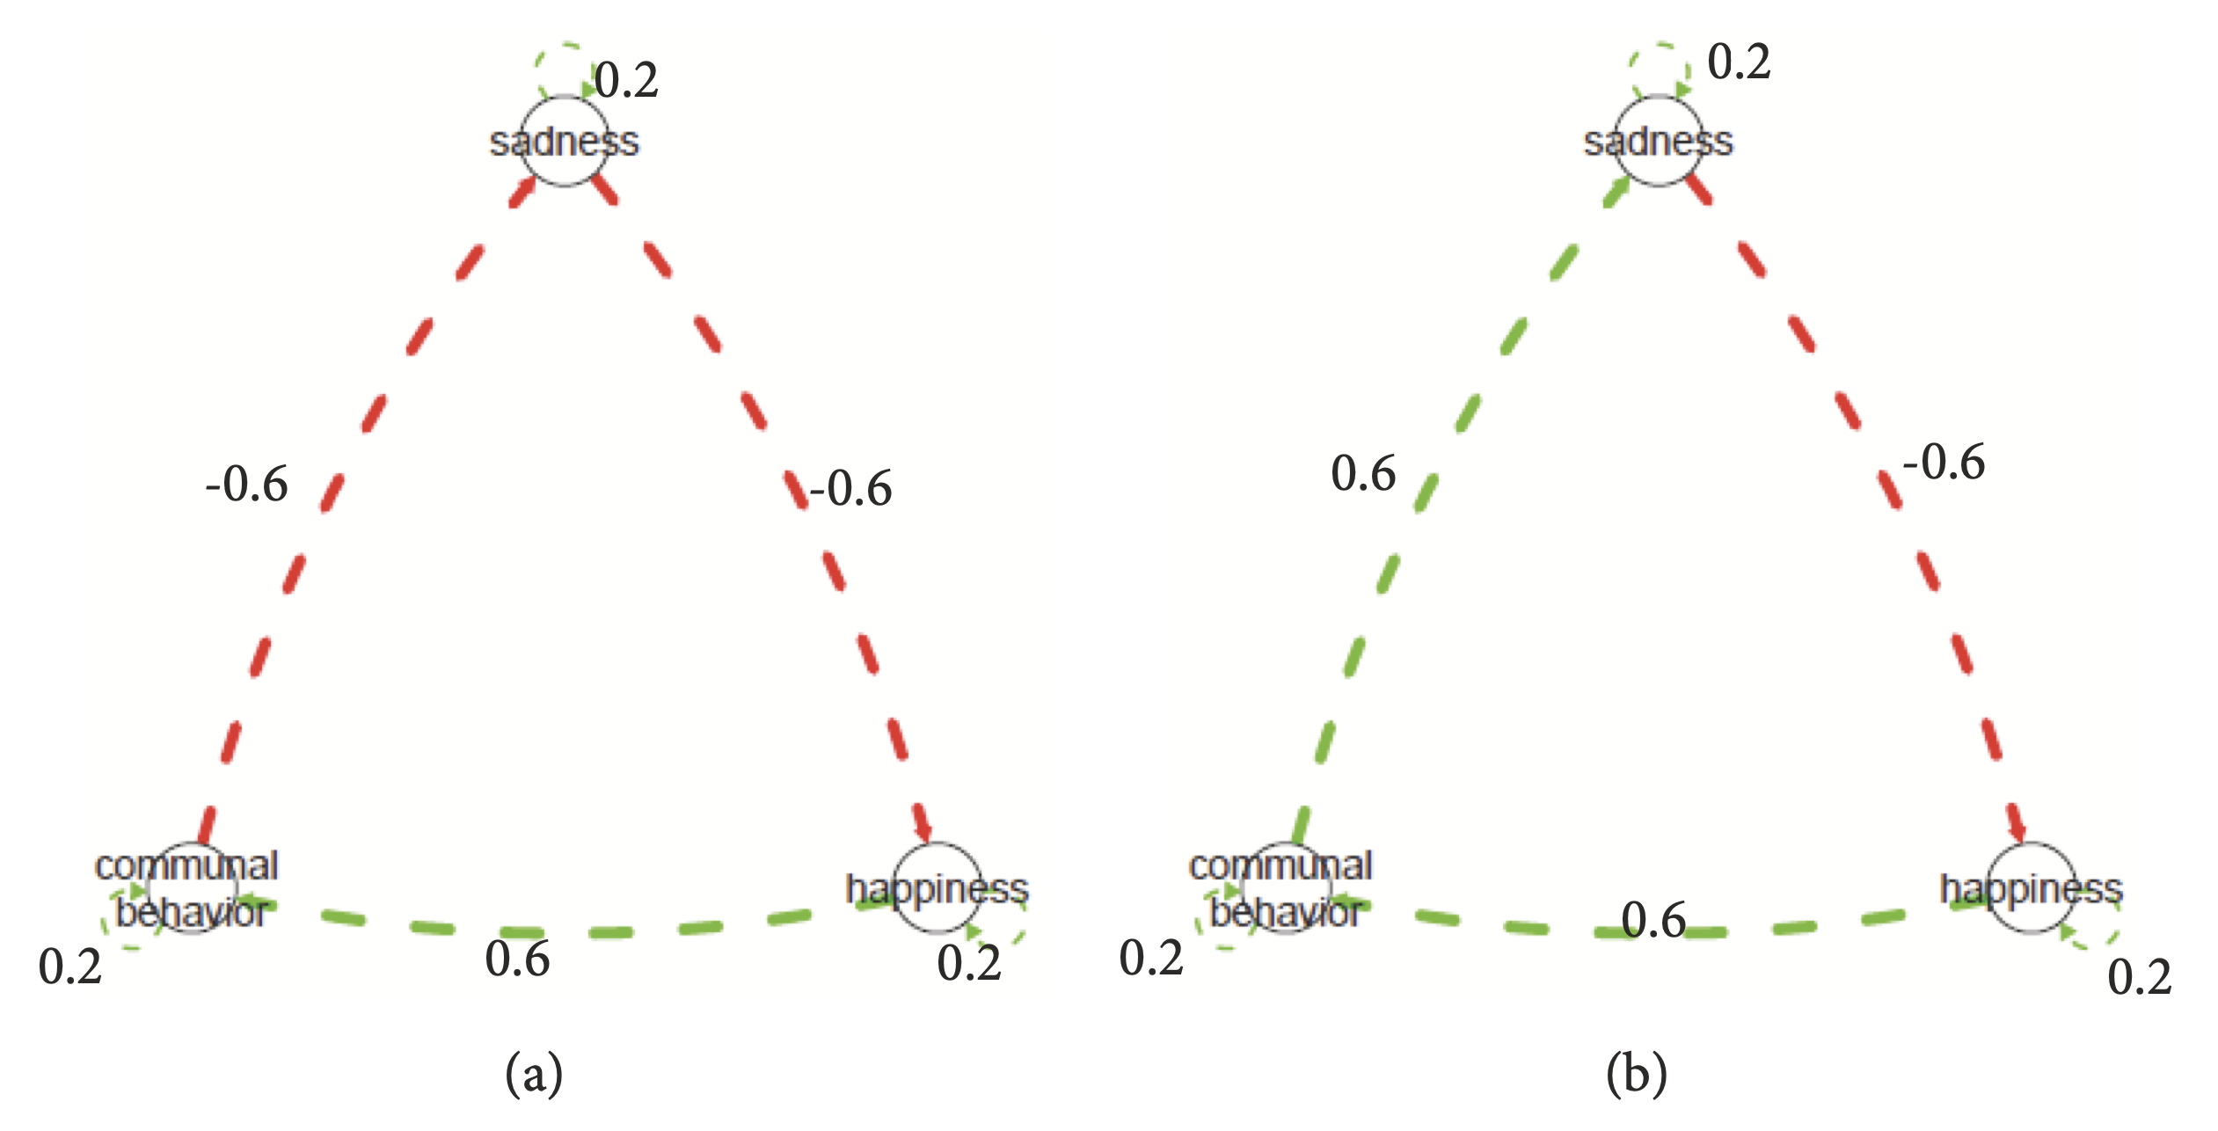
Notes:
Not resilient: In Individual A’s network (Figure 1(a)), higher sadness leads to lower happiness (a temporal relation where sadness influences subsequent happiness at -0.6), lower happiness leads to lower social engagement (a temporal relation where happiness influences subsequent communal behavior at +0.6), and lower social engagement leads to higher sadness (a temporal relation where communal behavior influences subsequent sadness at -0.6).
Hence the three temporal relations together form a positive feedback loop, a structure that sustains changes in sadness.
Resilient: The overall effect of this cyclic structure is negative (-0.6 ∗ 0.6 ∗ 0.6 = -0.216); hence the three temporal relations together form a negative feedback loop. Here, the structure of the relations facilitates regulation of sadness.

Slide 11
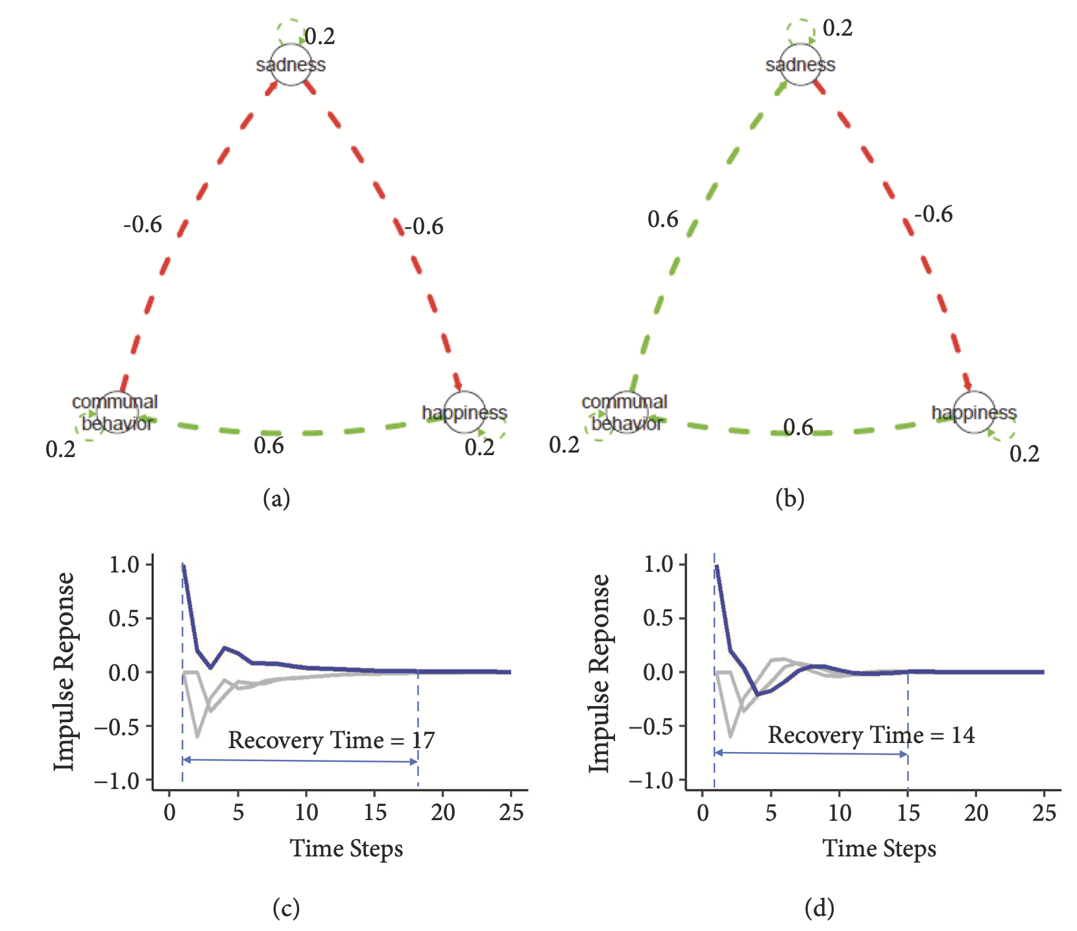
Yang, X., Ram, N., Gest, S. D., Lydon-Staley, D. M., Conroy, D. E., Pincus, A. L., & Molenaar, P. C. M. (2018). Socioemotional dynamics of emotion regulation and depressive symptoms: A person‐specific network approach. Complexity, 2018(1), 5094179. https://doi.org/10.1155/2018/5094179
Notes:
Not resilient: In Individual A’s network (Figure 1(a)), higher sadness leads to lower happiness (a temporal relation where sadness influences subsequent happiness at -0.6), lower happiness leads to lower social engagement (a temporal relation where happiness influences subsequent communal behavior at +0.6), and lower social engagement leads to higher sadness (a temporal relation where communal behavior influences subsequent sadness at -0.6).
Hence the three temporal relations together form a positive feedback loop, a structure that sustains changes in sadness.
Resilient: The overall effect of this cyclic structure is negative (-0.6 ∗ 0.6 ∗ 0.6 = -0.216); hence the three temporal relations together form a negative feedback loop. Here, the structure of the relations facilitates regulation of sadness.

Slide 12
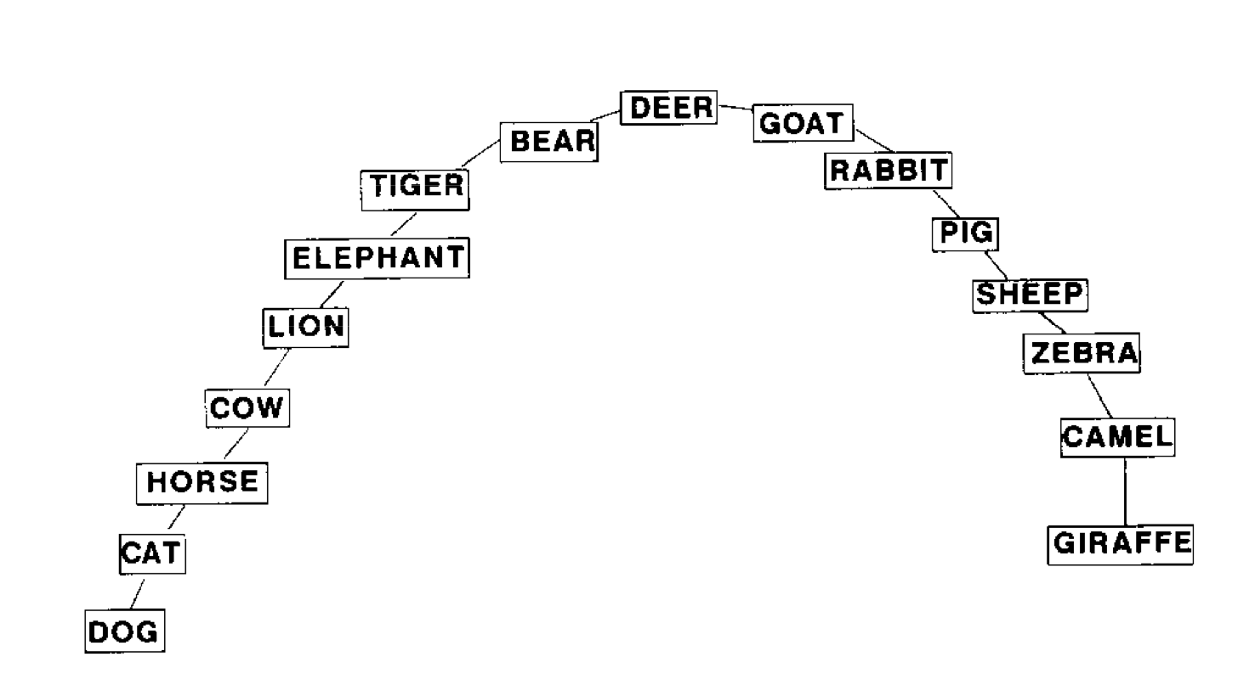
Notes:
Schizophrenia
Animal Fluency Test as part of the comprehensive neuropsychological evaluation
Subjects were asked to name as many animals as they could within 60 s. The semantic space analysis was performed on 16 target words (bear, camel, cat, cow, deer, dog, elephant, giraffe, goat, horse, lion, pig, rabbit, sheep, tiger, and zebra) that were among the 25 most frequent responses for the subjects and could be categorized into two possible dimensions (large-small, domestic-wild).
Pathfinder (PF) analysis

Slide 13
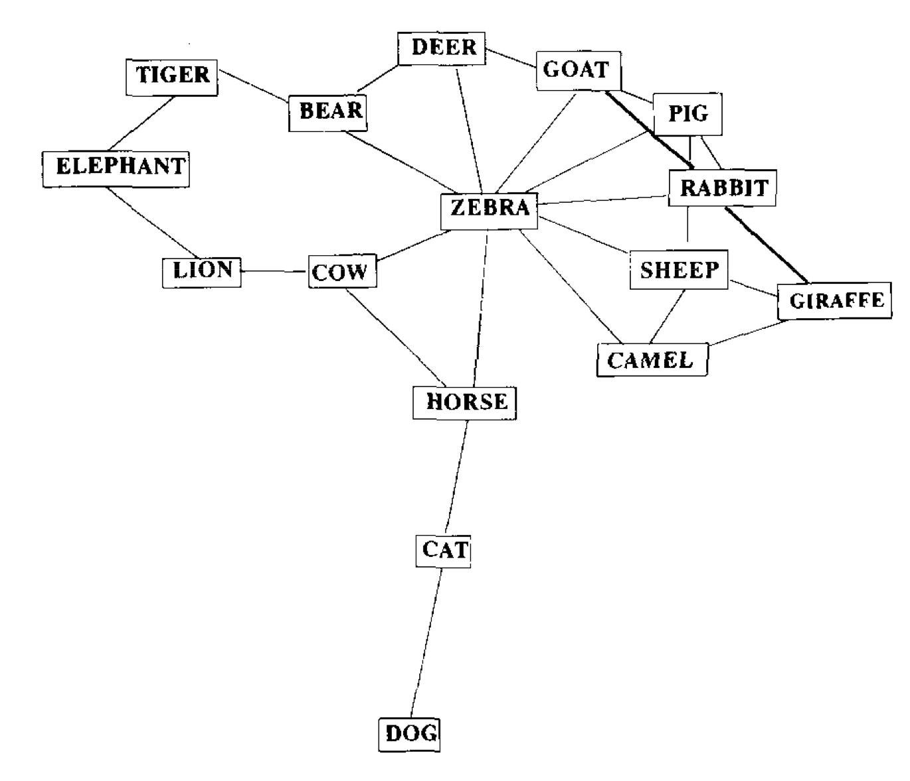
Notes:
Schizophrenia
Animal Fluency Test as part of the comprehensive neuropsychological evaluation
Subjects were asked to name as many animals as they could within 60 s. The semantic space analysis was performed on 16 target words (bear, camel, cat, cow, deer, dog, elephant, giraffe, goat, horse, lion, pig, rabbit, sheep, tiger, and zebra) that were among the 25 most frequent responses for the subjects and could be categorized into two possible dimensions (large-small, domestic-wild).
Pathfinder (PF) analysis

Slide 14

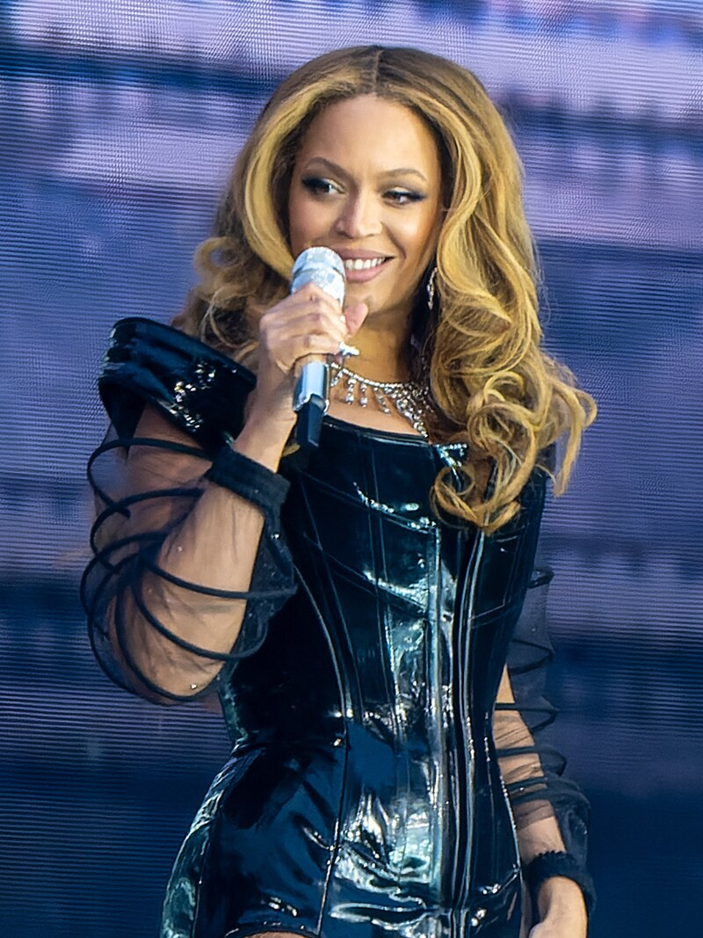
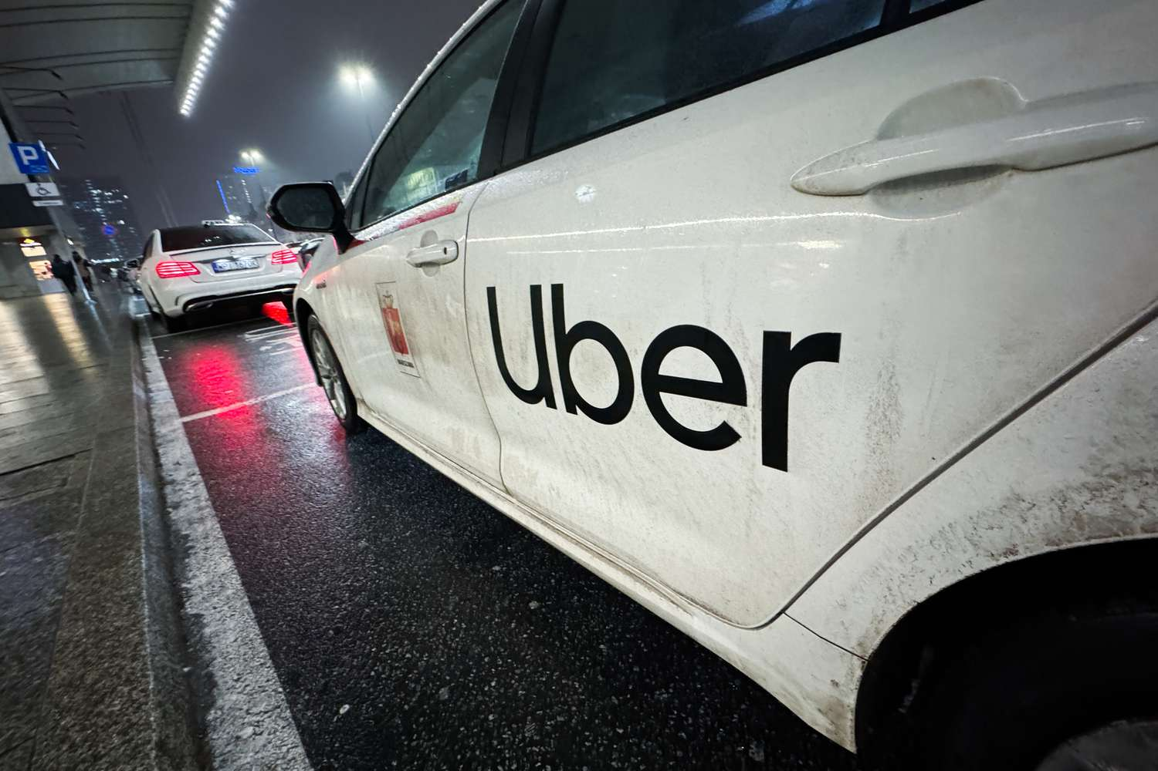



Brainstorm Time - What Networks Could Be?
Pick a topic
Think of a network
What’s the node? What’s the tie?
Node size/color? Tie width/color?
What will it tell us?

